Slide 1
Searching & Sorting

Slide 2
Sorting & Searching
Searching
Linear/Sequential Search
Binary Search
Sorting
Bubble sort
Selection Sort
Insertion Sort
Heapsort

Slide 3
Linear/Sequential Search
In computer science, linear search or sequential search is a method for finding a particular value in a list that consists of checking every one of its elements, one at a time and in sequence, until the desired one is found.
Linear search is the simplest search algorithm.
It is a special case of brute-force search.
Its worst case cost is proportional to the number of elements in the list.

Slide 4
Sequential Search – Algorithm & Example
# Input: Array A, integer key
# Output: first index of key in A
# or -1 if not found
Algorithm: Linear_Search
for i = 0 to last index of A:
if A[i] equals key:
return i
return -1
Search for 1 in given array
2 | 9 | 3 | 1 | 8
Comparing value of i^{th} index with element to be search one by one until we get searched element or end of the array
Step 1: i=0
Step 1: i=2
2 | 9 | 3 | 1 | 8
2 | 9 | 3 | 1 | 8
i
i
Step 1: i=1
Step 1: i=3
2 | 9 | 3 | 1 | 8
2 | 9 | 3 | 1 | 8
1
i
i
Element found at i^{th} index, i=3

Slide 5
Binary Search
If we have an array that is sorted, we can use a much more efficient algorithm called a Binary Search.
In binary search each time we divide array into two equal half and compare middle element with search element.
Searching Logic
If middle element is equal to search element then we got that element and return that index
if middle element is less than search element we look right part of array
if middle element is greater than search element we look left part of array.

Slide 6
Binary Search - Algorithm
# Input: Sorted Array A, integer key
# Output: Index of key in A,
# or -1 if not found
Algorithm: Binary_Search (A, left, right)
left = 0, right = n-1
while left < right
middle =(left+right)/2
if A[middle] matches key
return middle
else if key less than A[middle]
right = middle -1
else
left = middle + 1
return -1

Slide 7
Binary Search - Algorithm
Search for 6 in given array
-1 | 5 | 6 | 18 | 19 | 25 | 46 | 78 | 102 | 114
Index
0 | 1 | 2 | 3 | 4 | 5 | 6 | 7 | 8 | 9
left
right
Key=6, No of Elements = 10, so left = 0, right=9
Step 1:
middle index = (left + right) /2 = (0+9)/2 = 4
middle element value = a[4] = 19
Key=6 is less than middle element = 19, so right = middle – 1 = 4 – 1 = 3, left = 0
-1 | 5 | 6 | 18 | 19 | 25 | 46 | 78 | 102 | 114
Index
0 | 1 | 2 | 3 | 4 | 5 | 6 | 7 | 8 | 9
left
right

Slide 8
Binary Search - Algorithm
Step 2:
middle index = (left + right) /2 = (0+3)/2 = 1
middle element value = a[1] = 5
Key=6 is greater than middle element = 5, so left = middle + 1 =1 + 1 = 2, right = 3
-1 | 5 | 6 | 18 | 19 | 25 | 46 | 78 | 102 | 114
Index
0 | 1 | 2 | 3 | 4 | 5 | 6 | 7 | 8 | 9
left
right
Step 3:
middle index = (left + right) /2 = (2+3)/2 = 2
middle element value = a[2] = 6
Key=6 is equals to middle element = 6, so element found
-1 | 5 | 6 | 18 | 19 | 25 | 46 | 78 | 102 | 114
6
Index
0 | 1 | 2 | 3 | 4 | 5 | 6 | 7 | 8 | 9
Element Found

Slide 9
Sorting Algorithms
Bubble Sort, Selection Sort, Insertion Sort

Slide 10
Introduction
Sorting is any process of arranging items systematically or arranging items in a sequence ordered by some criterion.
Applications of Sorting
Phone Bill: the calls made are date wise sorted.
Bank statement or Credit card Bill: transactions made are date wise sorted.
Filling forms online: “select country” drop down box will have the name of countries sorted in Alphabetical order.
Online shopping: the items can be sorted price wise, date wise or relevance wise.
Files or folders on your desktop are sorted date wise.

Slide 11
Bubble Sort
Unlike selection sort, instead of finding the smallest record and performing the interchange, two records are interchanged immediately upon discovering that they are out of order
During the first pass R₁ and R₂ are compared and interchanged in case of our of order, this process is repeated for records R₂ and R₃, and so on.
This method will cause records with small key to move “bubble up”,
After the first pass, the record with largest key will be in the n^{th} position.
On each successive pass, the records with the next largest key will be placed in position n-1, n-2 ….., 2 respectively
This approached required at most n–1 passes, The complexity of bubble sort is O(n²)

Slide 12
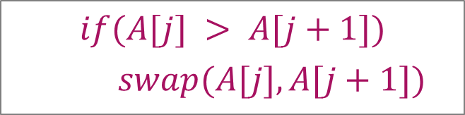
Bubble Sort – Example
Sort the following array in Ascending order
45 | 34 | 56 | 23 | 12
Pass 1 :
45
34
swap
34
34
34
34
45
45
45
45
56
56
56
23
swap
23
23
23
23
56
56
12
swap
12
12
12
12
56
$$if(A[j] > A[j+1])$$
$$swap(A[j],A[j+1])$$

Slide 13
Bubble Sort – Example
Pass 2 :
Pass 3 :
Pass 4 :
34
34
34
34
23
23
23
swap
12
swap
34
45
45
12
23
23
23
34
12
swap
swap
23
12
23
23
34
45
45
12
swap
12
34
12
12
12
45
45
45
45
56
56
56
56
56
56
$$if(A[j] > A[j+1])$$
$$swap(A[j],A[j+1])$$

Slide 14


Bubble Sort - Algorithm
# Input: Array A
# Output: Sorted array A
Algorithm: Bubble_Sort(A)
for i ← 1 to n-1 do
for j ← 1 to n-i do
if A[j] > A[j+1] then
swap(A[j], A[j+1])
$$θ\left(n\right)$$
temp ← A[j]
A[j] ← A[j+1]
A[j+1] ← temp
$$θ\left(n^{2}\right)$$

Slide 15
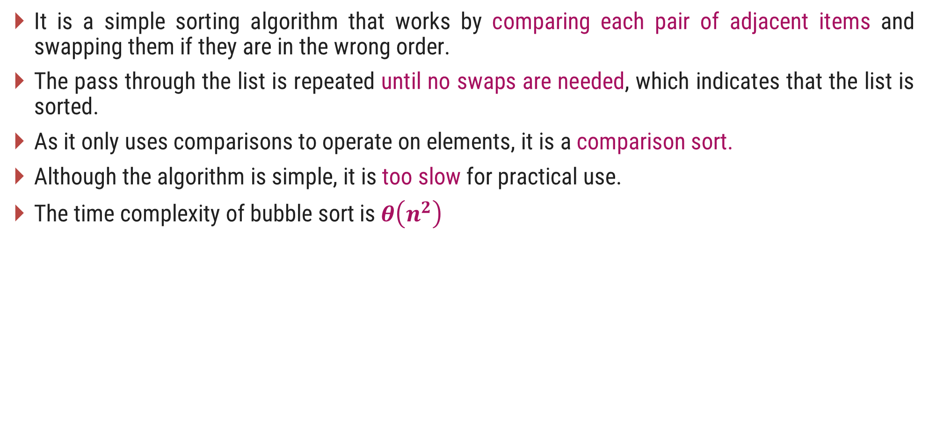
Bubble Sort
It is a simple sorting algorithm that works by comparing each pair of adjacent items and swapping them if they are in the wrong order.
The pass through the list is repeated until no swaps are needed, which indicates that the list is sorted.
As it only uses comparisons to operate on elements, it is a comparison sort.
Although the algorithm is simple, it is too slow for practical use.
The time complexity of bubble sort is $θ\left(n^{2}\right)$

Slide 16
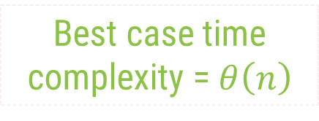
Bubble Sort Algorithm – Best Case Analysis
# Input: Array A
# Output: Sorted array A
Algorithm: Bubble_Sort(A)
int flag=1;
for i ← 1 to n-1 do
for j ← 1 to n-i do
if A[j] > A[j+1] then
flag = 0;
swap(A[j],A[j+1])
if(flag == 1)
cout<<"already sorted"<<endl
break;
Pass 1 :
i = 1
12
j = 1
23
j = 2
34
j = 3
Condition never becomes true
45
j = 4
59
Best case time complexity = $θ\left(n\right)$

Slide 17
Selection Sort
Selection sort is a simple sorting algorithm.
The list is divided into two parts,
The sorted part at the left end and
The unsorted part at the right end.
Initially, the sorted part is empty and the unsorted part is the entire list.
The smallest element is selected from the unsorted array and swapped with the leftmost element, and that element becomes a part of the sorted array.
This process continues moving unsorted array boundary by one element to the right.
This algorithm is not suitable for large data sets as its average and worst case complexities are of Ο(n²), where n is the number of items.

Slide 18
Selection Sort – Example 1
Sort the following elements in Ascending order
5 | 1 | 12 | -5 | 16 | 2 | 12 | 14
Step 1 :
Unsorted Array
5 | 1 | 12 | -5 | 16 | 2 | 12 | 14
1 | 2 | 3 | 4 | 5 | 6 | 7 | 8
Step 2 :
Min_i denotes the current index and Min_v is the value stored at current index.
So, Min_i = 1, Min_v = 5
Assume that currently Minx is the smallest value.
Now find the smallest value from the remaining entire Unsorted array.
Unsorted Array (elements 2 to 8)
5
-5
1
12
-5
5
16
2
12
14
1
2
3
4
5
6
7
8
Swap
Index = 4, value = -5

Slide 19
Selection Sort – Example 1
Step 3 :
Unsorted Array (elements 3 to 8)
Now Min_i = 2, Min_v = 1
Find min value from remaining unsorted array
-5
1
1
12
5
16
2
12
14
1
2
3
4
5
6
7
8
Index = 2, value = 1
No Swapping as min value is already at right place
Step 4 :
Unsorted Array
(elements 4 to 8)
Min_i = 3, Min_v = 12
Find min value from remaining unsorted array
-5
1
12
2
5
16
2
12
12
14
Index = 6, value = 2
1
2
3
4
5
6
7
8
Swap

Slide 20
Selection Sort – Example 1
Step 5 :
Unsorted Array
(elements 5 to 8)
Now Min_i = 4, Min_v = 5
Find min value from remaining unsorted array
-5
1
2
5
5
16
12
12
14
1
2
3
4
5
6
7
8
Index = 4, value = 5
No Swapping as min value is already at right place
Step 6 :
Min_i = 5, Min_v = 16
Find min value from remaining unsorted array
Unsorted Array
(elements 6 to 8)
Index = 6, value = 12
-5
1
2
5
16
12
12
16
12
14
1
2
3
4
5
6
7
8
Swap

Slide 21
Selection Sort – Example 1
Step 7 :
Unsorted Array
(elements 7 to 8)
Now Min_i = 6, Min_v = 16
Find min value from remaining unsorted array
-5
1
2
5
12
16
12
12
16
14
1
2
3
4
5
6
7
8
Index = 7, value = 12
Swap
Step 8 :
Unsorted Array
(element 8)
Min_i = 7, Min_v = 16
Find min value from remaining unsorted array
-5
1
2
5
12
12
16
14
14
16
Index = 8, value = 14
1
2
3
4
5
6
7
8
Swap
The entire array is sorted now.

Slide 22


Selection Sort - Algorithm
# Input: Array A
# Output: Sorted array A
Algorithm: Selection_Sort(A)
for i ← 1 to n-1 do
Min_i ← i;
Min_v ← A[i];
for j ← i + 1 to n do
if A[j] < minx then
Min_i ← j;
Min_v ← A[j];
A[minj] ← A[i];
A[i] ← minx;
$$θ\left(n\right)$$
$$θ\left(n^{2}\right)$$

Slide 23
Selection Sort – Example 2
Algorithm: Selection_Sort(A)
for i ← 1 to n-1 do
Min_i ← i; min_v ← A[i];
for j ← i + 1 to n do
if A[j] < min_v then
Min_i ← j ; min_v ← A[j];
A[min_i] ← A[i];
A[i] ← min_v;
Pass 1 :
i = 1
2
Min_i ← 1
34
34
No Change
Min_v ← 45
j = 2
3
A[j] = 34
56
Sort in Ascending order
45 | 34 | 56 | 23 | 12
45
1 | 2 | 3 | 4 | 5

Slide 24
Selection Sort – Example 2
Algorithm: Selection_Sort(A)
for i ← 1 to n-1 do
Min_i ← i; min_v ← A[i];
for j ← i + 1 to n do
if A[j] < min_v then
Min_i ← j ; min_v ← A[j];
A[min_i] ← A[i];
A[i] ← min_v;
Pass 1 :
i = 1
4
Min_i ← 2
5
Min_v ← 34
12
23
j = 2
3
4
5
A[j] = 23
12
Sort in Ascending order
Unsorted Array
45 | 34 | 56 | 23 | 12
45
45 | 34 | 56 | 23 | 12
12
45
1 | 2 | 3 | 4 | 5
1 | 2 | 3 | 4 | 5
Swap
34
56
34
45
45 | 34 | 56 | 23 | 45
12
23
56

Slide 25
Insertion Sort
In insertion sort, every iteration moves an element from unsorted portion to sorted portion until all the elements are sorted in the list.
Steps for Insertion Sort
1
Assume that first element in the list is in sorted portion of the list and remaining all elements are in unsorted portion.
2
Select first element from the unsorted list and insert that element into the sorted list in order specified.
3
Repeat the above process until all the elements from the unsorted list are moved into the sorted list.
This algorithm is not suitable for large data sets

Slide 26
Insertion Sort cont.
Complexity of the Insertion Sort Algorithm
To sort a unsorted list with 'n' number of elements we need to make (1+2+3+......+n-1) =
(n (n-1))/2 number of comparisons in the worst case.
If the list already sorted, then it requires 'n' number of comparisons.
Worst Case : Θ(n²)
Best Case : Ω(n)
Average Case : Θ(n²)

Slide 27
Insertion Sort Example
Sort given array using Insertion Sort
6
5
3
1
8
7
2
4
Pass - 1 : Select First Record and considered as Sorter Sub-array
6
5
3
1
8
7
2
4
Sorted
Unsorted
Pass - 2 : Select Second Record and Insert at proper place in sorted array
6
5
3
1
8
7
2
4
5
6
3
1
8
7
2
4
Sorted
Unsorted

Slide 28
Insertion Sort Example Cont.
Pass - 3 : Select Third record and Insert at proper place in sorted array
5
6
3
1
8
7
2
4
3
5
6
1
8
7
2
4
Sorted
Unsorted
Pass - 4 : Select Forth record and Insert at proper place in sorted array
3
5
6
1
8
7
2
4
1
3
5
6
8
7
2
4
Sorted
Unsorted

Slide 29
Insertion Sort Example Cont.
Pass - 5 : Select Fifth record and Insert at proper place in sorted array
1
3
5
6
8
7
2
4
8 is at proper position
1
3
5
6
8
7
2
4
Sorted
Unsorted
Pass - 6 : Select Sixth Record and Insert at proper place in sorted array
1
3
5
6
8
7
2
4
1
3
5
6
7
8
2
4
Sorted
Unsorted

Slide 30
Insertion Sort Example Cont.
Pass - 7 : Select Seventh record and Insert at proper place in sorted array
1
3
5
6
7
8
2
4
1
2
3
5
6
7
8
4
Sorted
Unsorted
Pass - 8 : Select Eighth Record and Insert at proper place in sorted array
1
2
3
5
6
7
8
4
1
2
3
4
5
6
7
8
Sorted
Unsorted

Slide 31
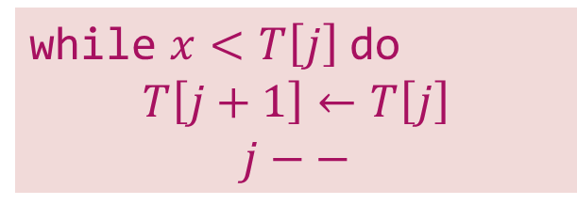



Insertion Sort – Example
Sort the following elements in Ascending order
5 | 1 | 12 | -5 | 16 | 2 | 12 | 14
Step 1 :
Unsorted Array
5 | 1 | 12 | -5 | 16 | 2 | 12 | 14
1 | 2 | 3 | 4 | 5 | 6 | 7 | 8
Step 2 :
$$j$$
$$i=2, x=1$$
$$j=i –1 and j>0$$
1
5
1
12
-5
16
2
12
14
while $x<T\left[j\right]$ do
$$T\left[j+1\right]←T\left[j\right]$$
$$j−−$$
1
2
3
4
5
6
7
8
Shift down

Slide 32

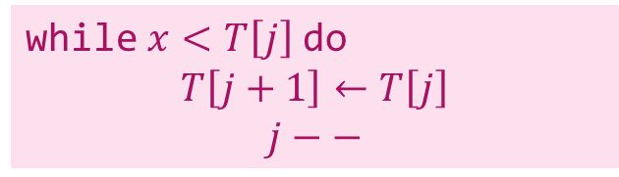


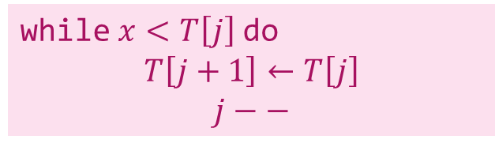




Insertion Sort – Example
Step 3 :
$$j$$
$$i=3, x=12$$
$$j=i –1 and j>0$$
1
5
12
-5
16
2
12
14
while $x<T\left[j\right]$ do
$$T\left[j+1\right]←T\left[j\right]$$
$$j−−$$
1
2
3
4
5
6
7
8
No Shift will take place
Step 4 :
$$i=4, x=−5$$
$$j=i –1 and j>0$$
$$j$$
while $x<T\left[j\right]$ do
$$T\left[j+1\right]←T\left[j\right]$$
$$j−−$$
$$j$$
-5
1
5
12
-5
16
2
12
14
1
2
3
4
5
6
7
8
Shift down
Shift down
Shift down

Slide 33




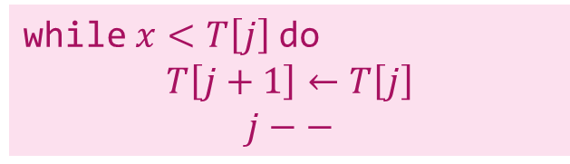


Insertion Sort – Example
Step 5 :
$$j$$
$$i=5, x=16$$
$$j=i –1 and j>0$$
-5
1
5
12
16
2
12
14
while $x<T\left[j\right]$ do
$$T\left[j+1\right]←T\left[j\right]$$
$$j−−$$
1
2
3
4
5
6
7
8
No Shift will take place
Step 6 :
$$i=6, x=2$$
$$j=i –1 and j>0$$
$$j$$
$$j$$
while $x<T\left[j\right]$ do
$$T\left[j+1\right]←T\left[j\right]$$
$$j−−$$
-5
1
2
5
12
16
2
12
14
1
2
3
4
5
6
7
8
Shift down
Shift down
Shift down

Slide 34
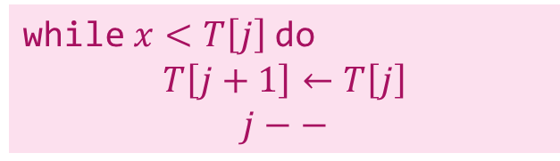






Insertion Sort – Example
Step 7 :
$$j$$
$$i=7, x=12$$
$$j=i –1 and j>0$$
-5
1
2
5
12
12
16
12
14
while $x<T\left[j\right]$ do
$$T\left[j+1\right]←T\left[j\right]$$
$$j−−$$
1
2
3
4
5
6
7
8
Shift down
Step 8 :
$$i=8, x=14$$
$$j=i –1 and j>0$$
$$j$$
while $x<T\left[j\right]$ do
$$T\left[j+1\right]←T\left[j\right]$$
$$j−−$$
-5
1
2
5
12
12
14
16
14
1
2
3
4
5
6
7
8
Shift down
The entire array is sorted now.

Slide 35


Insertion Sort - Algorithm
# Input: Array T
# Output: Sorted array T
Algorithm: Insertion_Sort(T[1,…,n])
for i ← 2 to n do
x ← T[i];
j ← i – 1;
while x < T[j] and j > 0 do
T[j+1] ← T[j];
j ← j – 1;
T[j+1] ← x;
$$θ\left(n\right)$$
$$θ\left(n^{2}\right)$$

Slide 36

Insertion Sort Algorithm – Best Case Analysis
# Input: Array T
# Output: Sorted array T
Algorithm: Insertion_Sort(T[1,…,n])
for i ← 2 to n do
x ← T[i];
j ← i – 1;
while x < T[j] and j > 0 do
T[j+1] ← T[j];
j ← j – 1;
T[j+1] ← x;
Pass 1 :
12
23
i=2
x=23
T[j]=12
34
i=3
x=34
T[j]=23
$$θ\left(n\right)$$
45
i=4
x=45
T[j]=34
59
i=5
x=59
T[j]=45
The best case time complexity of Insertion sort is $θ\left(n\right)$
The average and worst case time complexity of Insertion sort is $θ\left(n^{2}\right)$

Slide 37
Heap & Heap Sort Algorithm

Slide 38
Introduction
A heap data structure is a binary tree with the following two properties.
It is a complete binary tree: Each level of the tree is completely filled, except possibly the bottom level. At this level it is filled from left to right.
It satisfies the heap order property: the data item stored in each node is greater than or equal to the data item stored in its children node.
a
a
9
9
b
c
b
c
6
7
6
7
d
e
f
d
e
f
2
4
8
2
4
1
Binary Tree but not a Heap
Complete Binary Tree - Heap
Not a Heap
Heap

Slide 39
Array Representation of Heap
Heap can be implemented using an Array.
An array 𝐴 that represents a heap is an object with two attributes:
𝑙𝑒𝑛𝑔𝑡ℎ[𝐴], which is the number of elements in the array, and
ℎ𝑒𝑎𝑝−𝑠𝑖𝑧𝑒[𝐴], the number of elements in the heap stored within array 𝐴
16
14
10
8
7
9
3
Array representation of heap
2
4
1
16
14
10
8
7
9
3
2
4
1
Heap

Slide 40

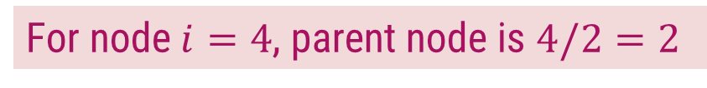









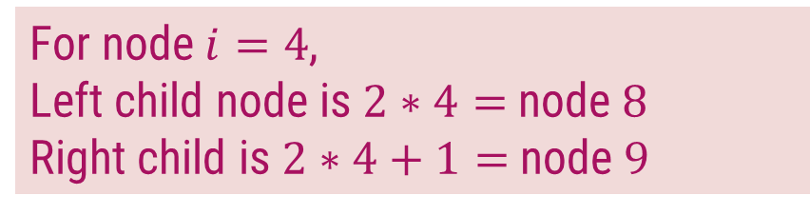
Array Representation of Heap
In the array 𝐴, that represents a heap
length[𝐴] = heap-size[𝐴]
For any node 𝒊 the parent node is 𝒊/𝟐
For any node 𝒊, its left child is 𝟐𝒊 and right child is 𝟐𝒊 +𝟏
For node $i=4$, parent node is $4/2=2$
$$1$$
16
For node $i=4$,
Left child node is $2∗4=$node $8$
Right child is $2∗4+1=$node $9$
$$2$$
$$3$$
14
10
$$4$$
$$5$$
$$6$$
$$7$$
8
7
9
3
$$1$$ | $$2$$ | $$3$$ | $$4$$ | $$5$$ | $$6$$ | $$7$$ | $$8$$ | $$9$$ | $$10$$
$$8$$
$$9$$
$$10$$
14
8
2
4
2
4
1
16
14
10
8
7
9
3
2
4
1
Heap

Slide 41
Types of Heap
Max-Heap − Where the value of the root node is greater than or equal to either of its children.
9
6
7
2
4
1
1
Min-Heap − Where the value of the root node is less than or equal to either of its children.
2
4
6
7
9

Slide 42
Introduction to Heap Sort
Build the complete binary tree using given elements.
Create Max-heap to sort in ascending order.
Once the heap is created, swap the last node with the root node and delete the last node from the heap.
Repeat step 2 and 3 until the heap is empty.

Slide 43

Heap Sort – Example 1
Sort the following elements in Ascending order
4 | 10 | 3 | 5 | 1
Step 1 : Create Complete Binary Tree
4
$$1$$ | $$2$$ | $$3$$ | $$4$$ | $$5$$
4 | 10 | 3 | 5 | 1
10
3
Now, a binary tree is created and we have to convert it into a Heap.
5
1

Slide 44
Heap Sort – Example 1
Sort the following elements in Ascending order
4 | 10 | 3 | 5 | 1
Step 2 : Create Max Heap
4
10
10 is greater than 4
So, swap 10 & 4
$$1$$ | $$2$$ | $$3$$ | $$4$$ | $$5$$
4 | 10 | 3 | 5 | 1
10
4
10
3
4
Swap
In a Max Heap, parent node is always greater than or equal to the child nodes.
5
1

Slide 45
Heap Sort – Example 1
Sort the following elements in Ascending order
4 | 10 | 3 | 5 | 1
Step 2 : Create Max Heap
10
5 is greater than 4
So, swap 5 & 4
$$1$$ | $$2$$ | $$3$$ | $$4$$ | $$5$$
10 | 4 | 3 | 5 | 1
5
4
4
3
5
Swap
In a Max Heap, parent node is always greater than or equal to the child nodes.
5
1
4
Max Heap is created

Slide 46
Heap Sort – Example 1
Sort the following elements in Ascending order
4 | 10 | 3 | 5 | 1
Step 3 : Apply Heap Sort
10
1
$$1$$ | $$2$$ | $$3$$ | $$4$$ | $$5$$
10 | 5 | 3 | 4 | 1
1
10
5
3
Swap
Swap the first and the last nodes and
Delete the last node.
4
1
10

Slide 47
Heap Sort – Example 1
Sort the following elements in Ascending order
4 | 10 | 3 | 5 | 1
Step 3 : Apply Heap Sort
1
5
Max Heap Property is violated so, create a Max Heap again.
$$1$$ | $$2$$ | $$3$$ | $$4$$ | $$5$$
1 | 5 | 3 | 4 | 10
5
1
1
4
5
3
1
4
Swap
4
1

Slide 48
Heap Sort – Example 1
Sort the following elements in Ascending order
4 | 10 | 3 | 5 | 1
Step 3 : Apply Heap Sort
5
1
Max Heap is created
$$1$$ | $$2$$ | $$3$$ | $$4$$ | $$5$$
5 | 4 | 3 | 1 | 10
1
5
4
3
Swap
Swap the first and the last nodes and
Delete the last node.
1
5

Slide 49
Heap Sort – Example 1
Sort the following elements in Ascending order
4 | 10 | 3 | 5 | 1
Step 3 : Apply Heap Sort
1
Create Max Heap again
3
4
$$1$$ | $$2$$ | $$3$$ | $$4$$ | $$5$$
1 | 4 | 3 | 5 | 10
4
1
4
3
Max Heap is created
4
3
1
4
Swap
Swap the first and the last nodes and
Delete the last node.

Slide 50
Heap Sort – Example 1
Sort the following elements in Ascending order
4 | 10 | 3 | 5 | 1
Step 3 : Apply Heap Sort
3
Already a Max Heap
1
$$1$$ | $$2$$ | $$3$$ | $$4$$ | $$5$$
3 | 1 | 4 | 5 | 10
1
3
1
3
Swap
Swap the first and the last nodes and
Delete the last node.

Slide 51
Heap Sort – Example 1
Sort the following elements in Ascending order
4 | 10 | 3 | 5 | 1
Step 3 : Apply Heap Sort
1
Already a Max Heap
$$1$$ | $$2$$ | $$3$$ | $$4$$ | $$5$$
1 | 3 | 4 | 5 | 10
1
Remove the last element from heap and the sorting is over.

Slide 52
Heap Sort – Example 2
Sort given element in ascending order using heap sort. 19, 7, 16, 1, 14, 17
19 | 7 | 16 | 1 | 14 | 17
14
17
7
16
Step 1: Create binary tree
Step 2: Create Max-heap
19
19
7
16
7
16
14
17
1
14
17
1
14
17
7
16

Slide 53
Heap Sort – Example 2
Step 3
Step 4
19 | 14 | 17 | 1 | 7 | 16
16 | 14 | 17 | 1 | 7 | 19
16
19
17
16
19
16
Create Max-heap
16
17
Swap & remove the last element
14
17
14
17
16
1
7
16
1
7
19

Slide 54
Heap Sort – Example 2
Step 5
Step 6
17 | 14 | 16 | 1 | 7 | 19
7 | 14 | 16 | 1 | 17 | 19
7
17
16
7
17
7
Create Max-heap
7
16
Swap & remove the last element
14
16
14
16
7
1
7
1
17

Slide 55
Heap Sort – Example 2
Step 7
Step 8
16 | 14 | 7 | 1 | 17 | 19
1 | 14 | 7 | 16 | 17 | 19
1
16
14
1
16
1
Create Max-heap
1
14
Swap & remove the last element
14
7
14
7
1
1
16

Slide 56
Heap Sort – Example 2
Step 9
Step 10
14 | 1 | 7 | 16 | 17 | 19
7 | 1 | 14 | 16 | 17 | 19
7
14
1
7
14
7
Already a Max-heap
7
Swap & remove the last element
1
Swap & remove the last element
1
7
1
14
7
Step 11
1 | 7 | 14 | 16 | 17 | 19
1 | 7 | 14 | 16 | 17 | 19
1
Remove the last element
The entire array is sorted now.

